Slide 1

Automatic Computation of Percentage of Nuclear GFP for an Image
APAC Digital Solutions
2020-12-04

Slide 2
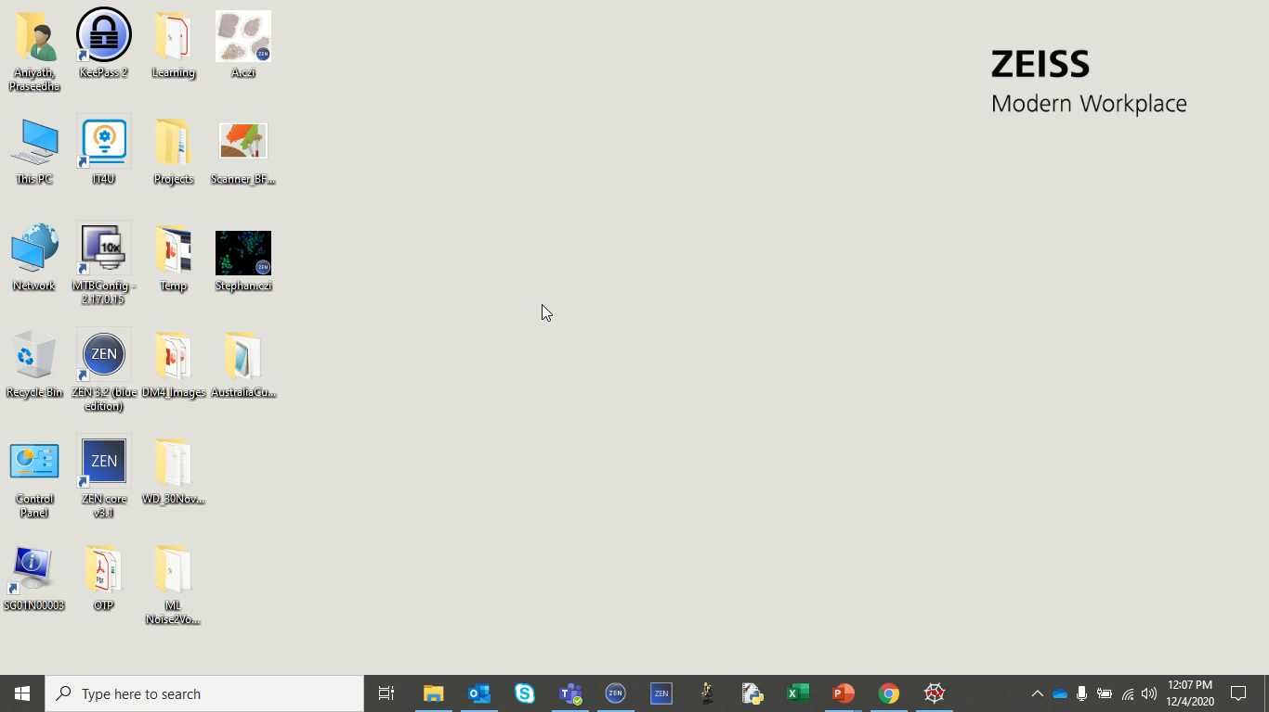
Step 1: Copy the downloaded Image Analysis Setting (Compute_GFP_Ratio.czias) to the following location - C:\Users\Public\Public Documents\Carl Zeiss\ZEN\Documents\Image Analysis Settings

Slide 3
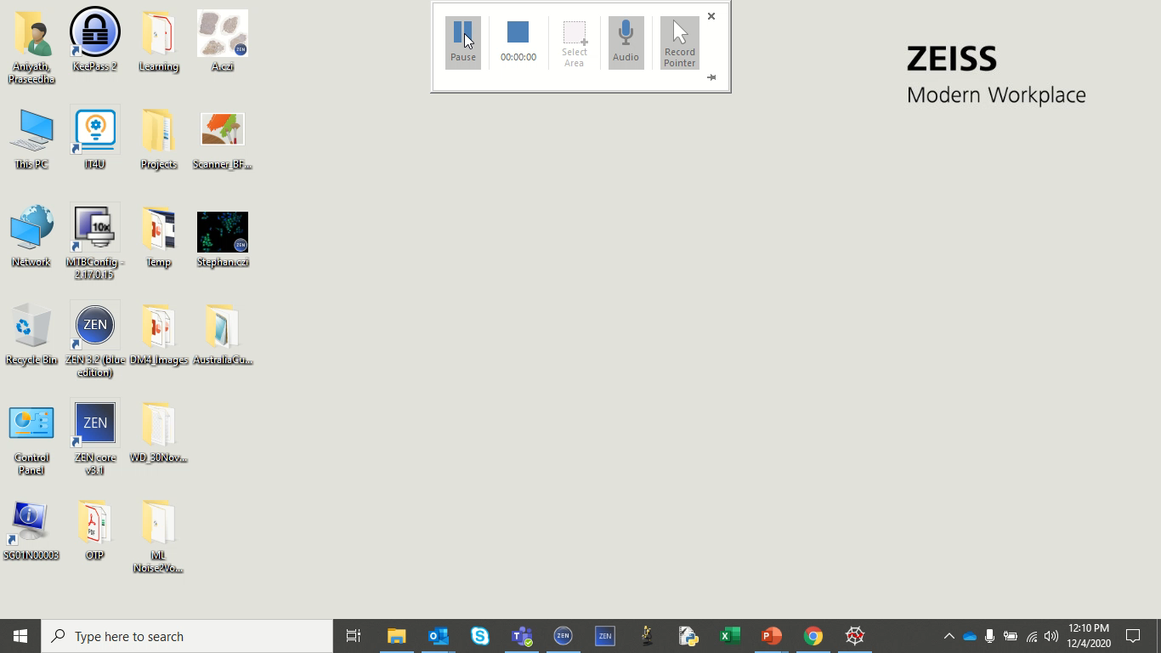
Step 2: Copy the downloaded macro (Compute_GFP_Ratio.czmac) to the following location - C:\Users\Public\Public Documents\Carl Zeiss\ZEN\Documents\Macros

Slide 4
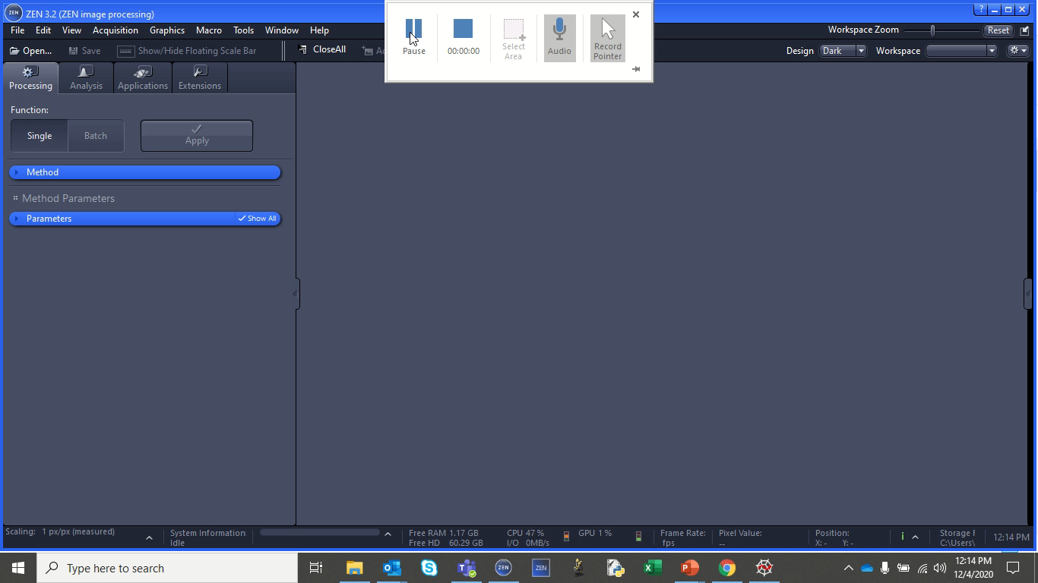
Step 3: Load the input image in ZEN Blue and execute the macro (Compute_GFP_Ratio.czmac) from the Macro Editor Window. Select the Image Analysis Setting (Compute_GFP_Ratio.czias) when the GUI pops up. The percent of nuclear GFP w.r.t the total GFP is generated and displayed in a ZEN Table. The average percent of nuclear GFP for the image is also displayed.

